Slide 1
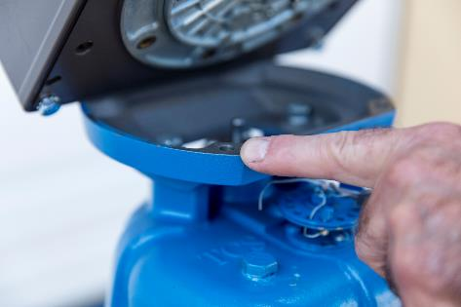
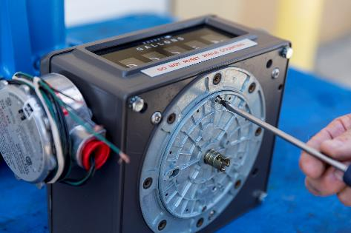
Replacing the Pulser
Replacing the pulser can be done without removing the pulser and register from the stand.
Remove 7/16” bolts (4) that attaches the Meter to the Register.
Remove Gear plate by removing 2 flathead screws from the bottom of the register.

Slide 2
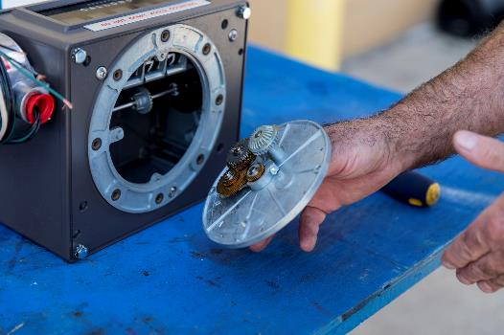
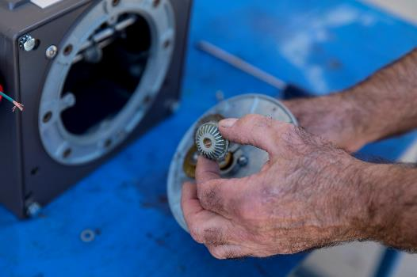
Replacing the Pulser
Remove Gear Plate from the bottom of the Register.
Be careful not to drop the gear and the washer as you are removing the Gear Plate.

Slide 3
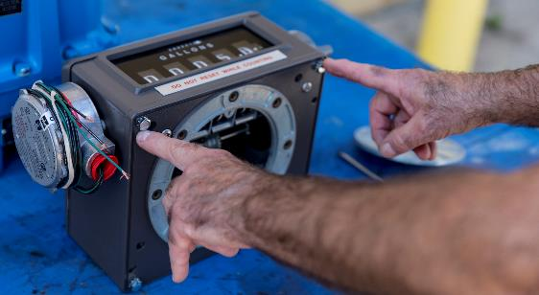
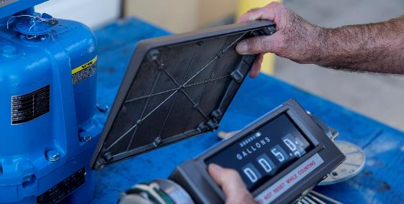
Replacing the Pulser
Remove 7/16” bolts (4) that attaches the Register Lid to the top of the Register.
Remove Register Lid from Register

Slide 4
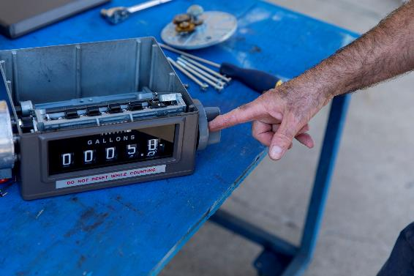
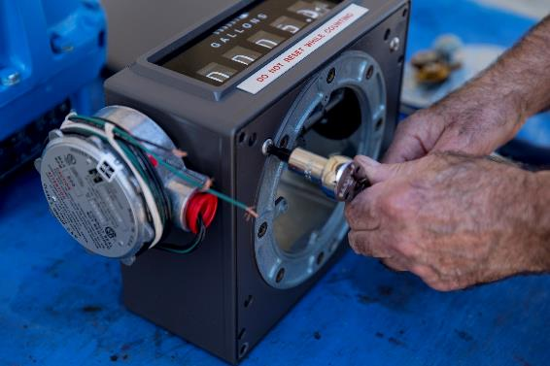
Replacing the Pulser
Remove the Reset Knob by unscrewing it from Register.
Remove the Inner Register by removing 3 screws with #30 Torx Bit.

Slide 5
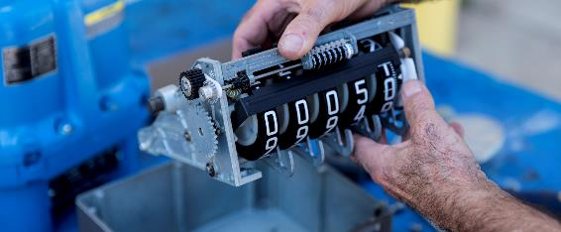
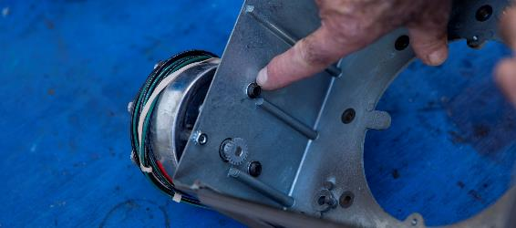
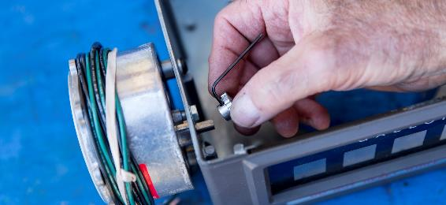
Replacing the Pulser
Remove Inner Register
Remove 5/32” Allen Head Bolts (2) and one nut from side
Remove gear by loosening 1/16” set screw

Slide 6
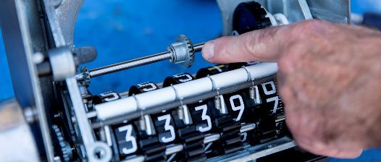
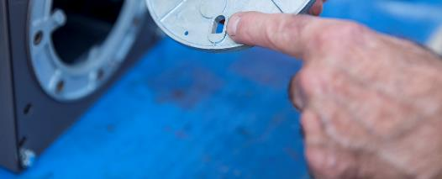
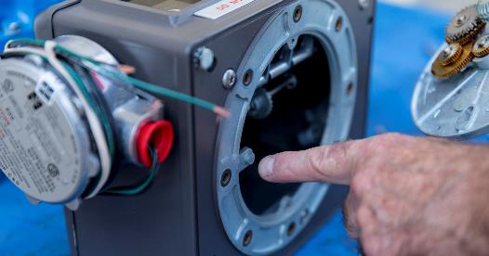
Replacing the Pulser
Bevel Gear can move so when installing the Gear plate be careful to make sure it is in the center and aligned with the gears.
When putting the Gear Plate back onto the Register there is a slot on the plate that aligns with the nipple on the Register.

Slide 7
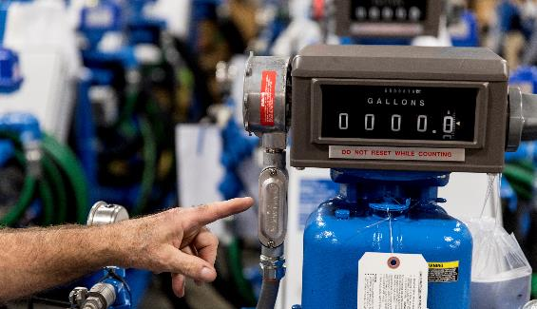
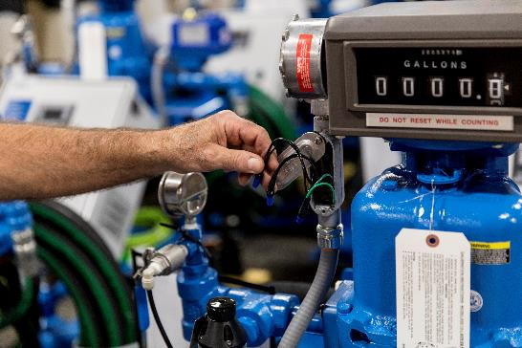
Replacing the Pulser
Wire in the new pulser

